Slide 1
2. Limitations and intepretations of ERPs

Slide 2
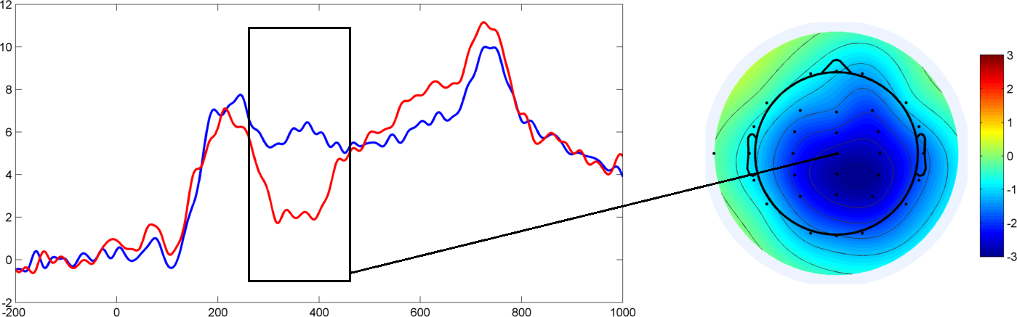
The N400
I drink my coffee with cream and sugar.
I drink my coffee with cream and dog.
Amplitude (µV)
Time from onset of critical word (ms)
Figure adapted from Hunt, Politzer-Ahles, Gibson, Minai, & Fiorentino (2013)

Slide 3
Typical plausibility-N400 stimuli
He spread the bread with butter/socks.
I take my coffee with cream and sugar/dog.
They drank champagne to celebrate their twelfth wedding anniversary/flag.
He spread the bread with butter/socks.
I take my coffee with cream and sugar/dog.
They drank champagne to celebrate their twelfth wedding anniversary/flag.

Slide 4
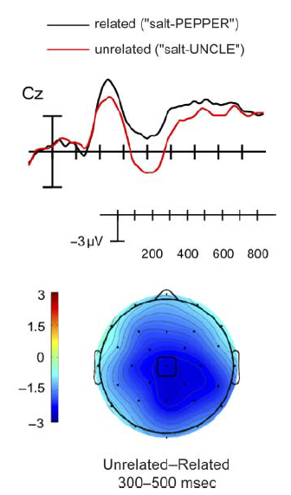
salt
500 ms
100 ms
UNCLE
900 ms
Figure adapted from Lau, Holcomb, & Kuperberg (2013)
See also Kutas (1993)

Slide 5
Is the N400 for implausible sentences based on actual sentence-level comprehension, or just on the semantic associations between words?

Slide 6
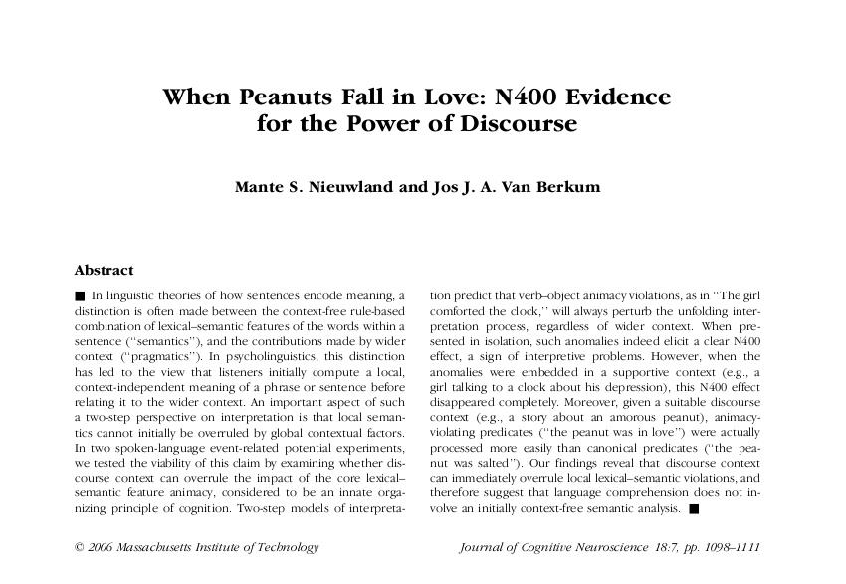


Slide 7
A woman saw a dancing peanut who had a big smile on his face. The peanut was singing about a girl he had just met. And judging from the song, the peanut was totally crazy about her. The woman thought it was really cute to see the peanut singing and dancing like that. The peanut was salted/in love, and by the sound if it, this was definitely mutual. He was seeing a little almond.
Nieuwland & Van Berkum (2006)

Slide 8
Predictions
If the N400 is based on word associations…
If the N400 is based on the whole sentence context…
salted: related
in love: unrelated
Bigger N400 for in love
salted: doesn’t fit the context
in love: fits the context
Bigger N400 for salted

Slide 9
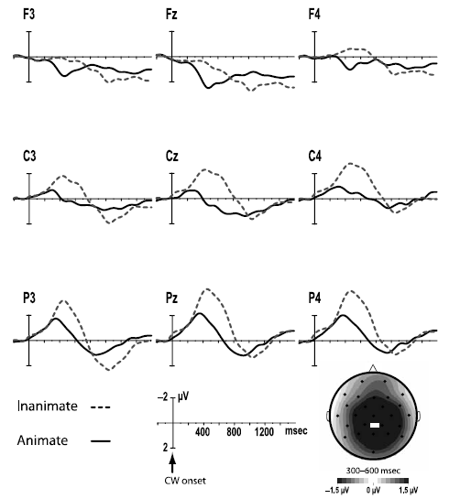
…peanut was salted
…peanut was in love
Nieuwland & Van Berkum (2006)

Slide 10
The N400 is not just looking at relationships between words; it’s sensitive to discourse-level information!

Slide 11
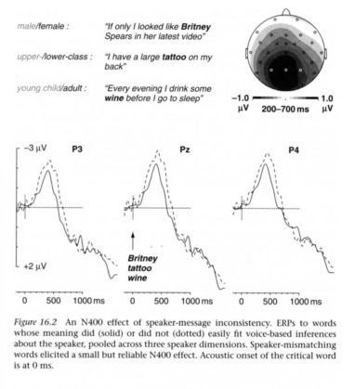
Van Berkum (2010)

Slide 12
After giving birth, the new mother really wanted to have a cigarette/chicken soup.
Large N400 for L1-Chinese L2-English speakers
Large N400 for British English speakers
Wu & Thierry

Slide 13
SOME (有的)
Semantic
  “more than zero”
Pragmatic
  “not all” (并非所有的)

Slide 14
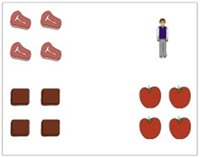
This is a story about a student who wants to cut steaks, brownies, and tomatoes. Let’s see what happens!
Hunt, Politzer-Ahles, et al. (2013, Neuroscience Letters)

Slide 15
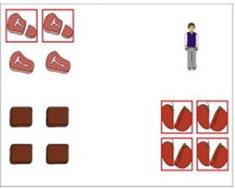
The
student
cut
some
of
the
steaks
in
this
story.
Hunt, Politzer-Ahles, et al. (2013, Neuroscience Letters)

Slide 16
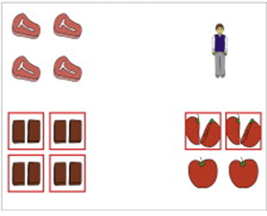
The
student
cut
some
of
the
steaks
in
this
story.
Hunt, Politzer-Ahles, et al. (2013, Neuroscience Letters)

Slide 17
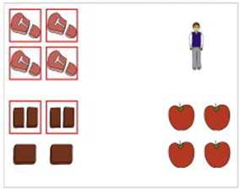
The
student
cut
some
of
the
steaks
in
this
story.
Hunt, Politzer-Ahles, et al. (2013, Neuroscience Letters)

Slide 18
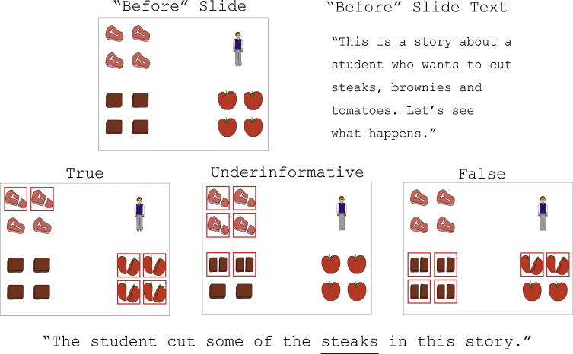
Correct
Pragmatic violation
Semantic violation
Hunt, Politzer-Ahles, et al. (2013, Neuroscience Letters)

Slide 19
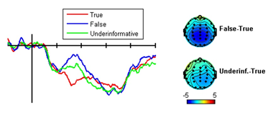
Correct
Semantic
Pragmatic
Semantic - Correct
-2.5
Pragmatic - Correct
12.5
Hunt, Politzer-Ahles, et al. (2013, Neuroscience Letters)

Slide 20
Conclusions about N400?
“N400 is the correlate of pragmatics!”
N400 is still a correlate of prediction…
  And pragmatics can influence your predictions

Slide 21
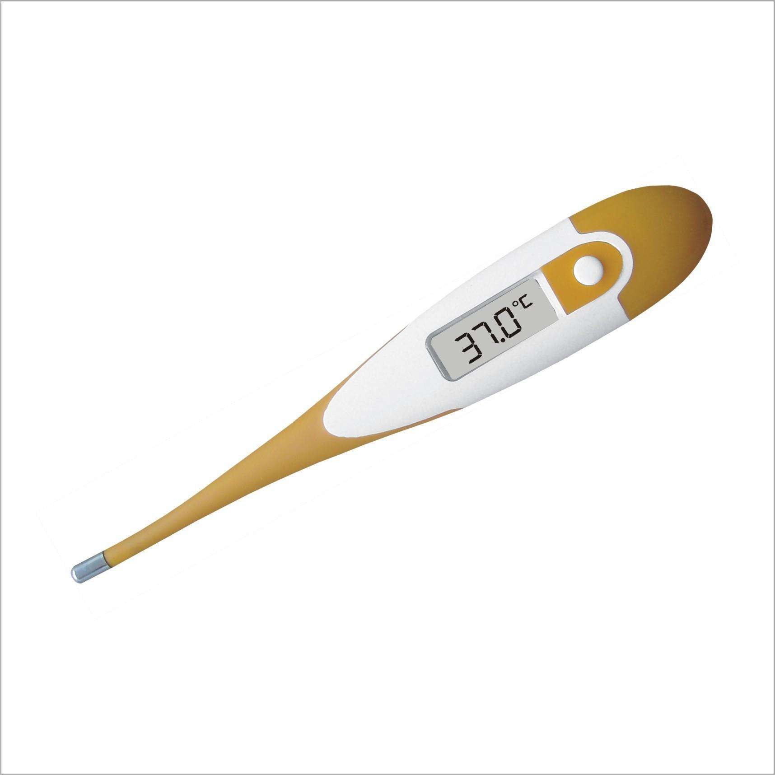
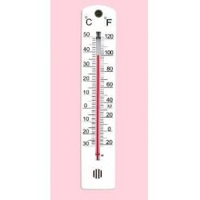

Slide 22
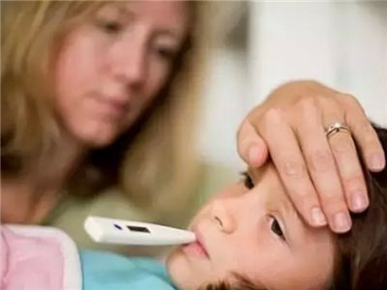
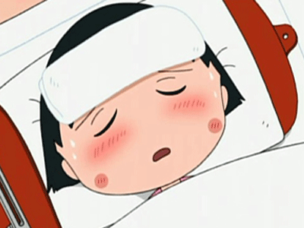

Slide 23
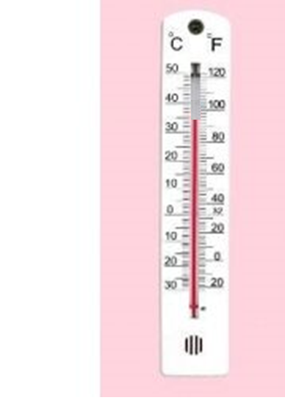

Slide 24
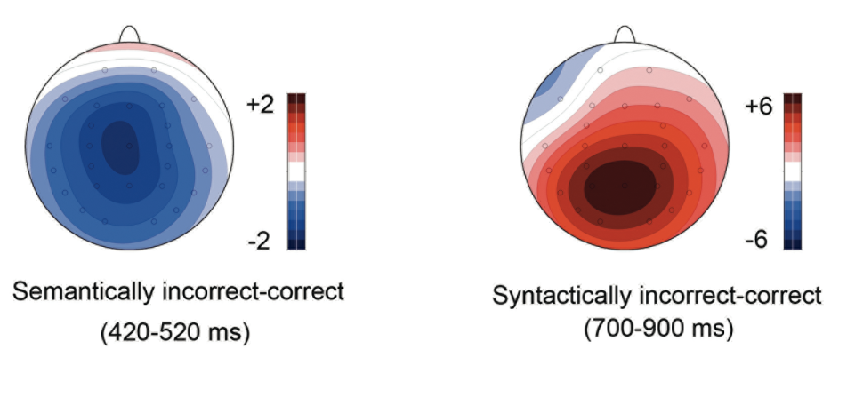
N400 vs. P600
I drank my coffee with sugar/dog.
All the students were/was in the classroom.
Figure from Schacht et al. (2014)
Notes:
For the first point: 1) answers to direct questions like that

Slide 25
Tucker et al. (in prep)
The keys to the cabinets is on the table.
The key to the cabinet is on the table.

Slide 26
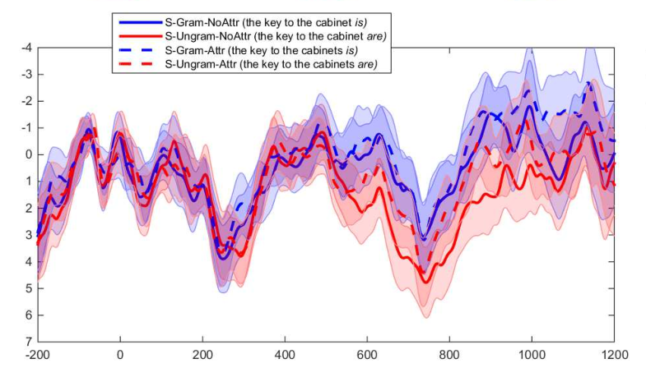
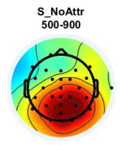

Slide 27
Xu et al. (2013)
这些女患者情绪低落，医生鼓励她振作起來。
这位女患者情绪低落，医生鼓励她振作起來 。

Slide 28
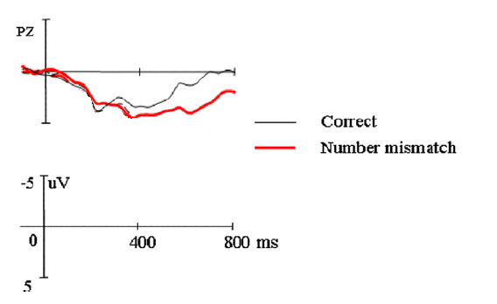

Slide 29
Ye et al. (2006)
伐木工开採森林，把松鼠裁了。
设计师制作新衣，把布料裁了。

Slide 30
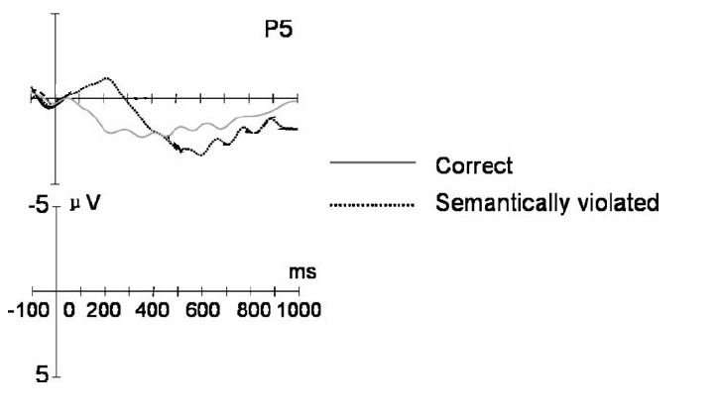

Slide 31
Kim & Osterhout (2005)
The hearty meal was devouring the kids.
The hearty meal was devoured by the kids.

Slide 32
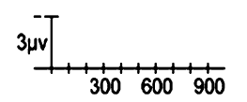
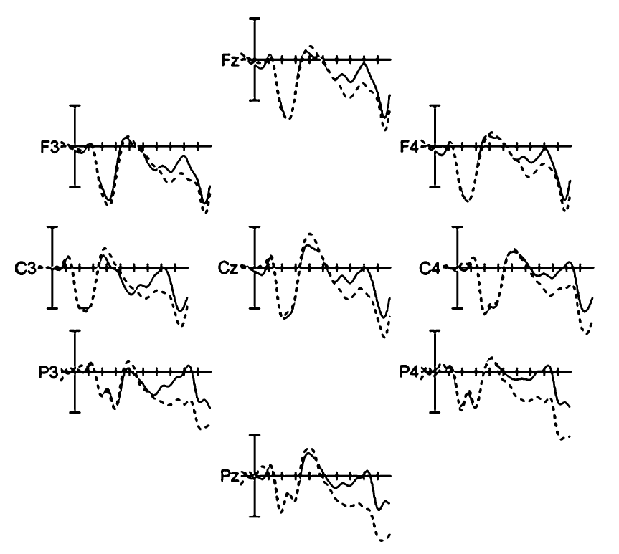
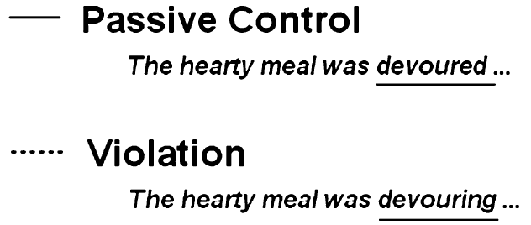
P600!

Slide 33
N400 vs. P600
N400: I drink my coffee with cream and dog…
  Brain: “That sentence is weird! We don’t drink dogs! Should be sugar, not dog!”
P600: All the students was in the classroom…
  Brain: “That sentence is weird! Should be were, not was!”

Slide 34
Kim & Osterhout
The hearty meal was devouring…
Brain: “That sentence is weird, meals don’t devour things!” → N400
OR
Brain: “That sentence is weird, should have been devoured!” → P600

Slide 35
Kim & Osterhout
Trust the syntax, and decide that the meaning is weird
Brain: “That sentence is weird, meals don’t devour things!” → N400
OR
Brain: “That sentence is weird, should have been devoured!” → P600
Trust the meaning, and decide that the syntax was wrong for expressing that meaning

Slide 36
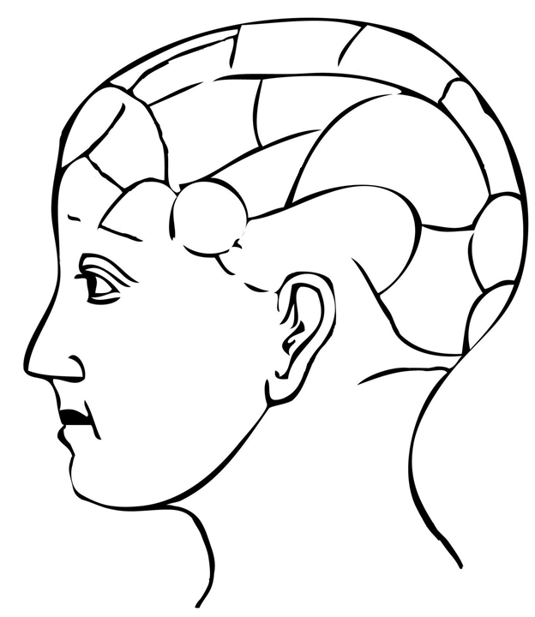
X
phonology
morphology
pragmatics
phonetics
syntax
semantics

Slide 37
heirarchical chunking
repair
prediction
re-analysis
integration

Slide 38
Two kinds of hypothesis
Effect-specific hypothesis
Effect-nonspecific hypothesis

Slide 39
Effect-specific hypothesis
“I predict that this word will elicit a bigger P600 than that word…”

Slide 40
Effect-nonspecific hypothesis
“I predict that these two words will elicit different effects somehow, I want to see how they will be different…”

Slide 41
Try to use effect-specific hypotheses!

Slide 43
van Turrenout et al. (1998)
EEG as a window into things that you thought about doing, but never actually did

Slide 44
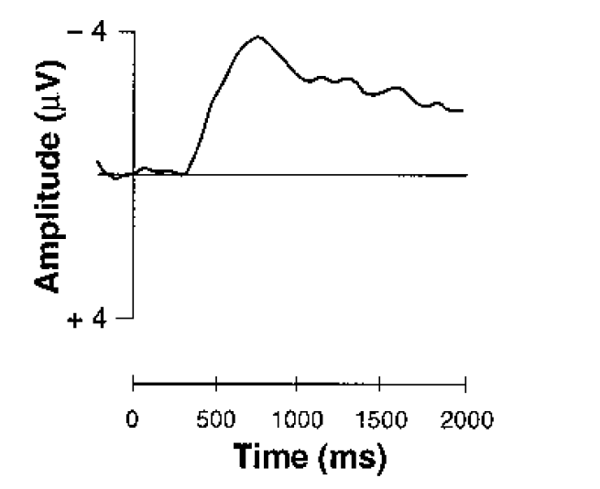
Lateralized readiness potential (LRP)
press

Slide 45
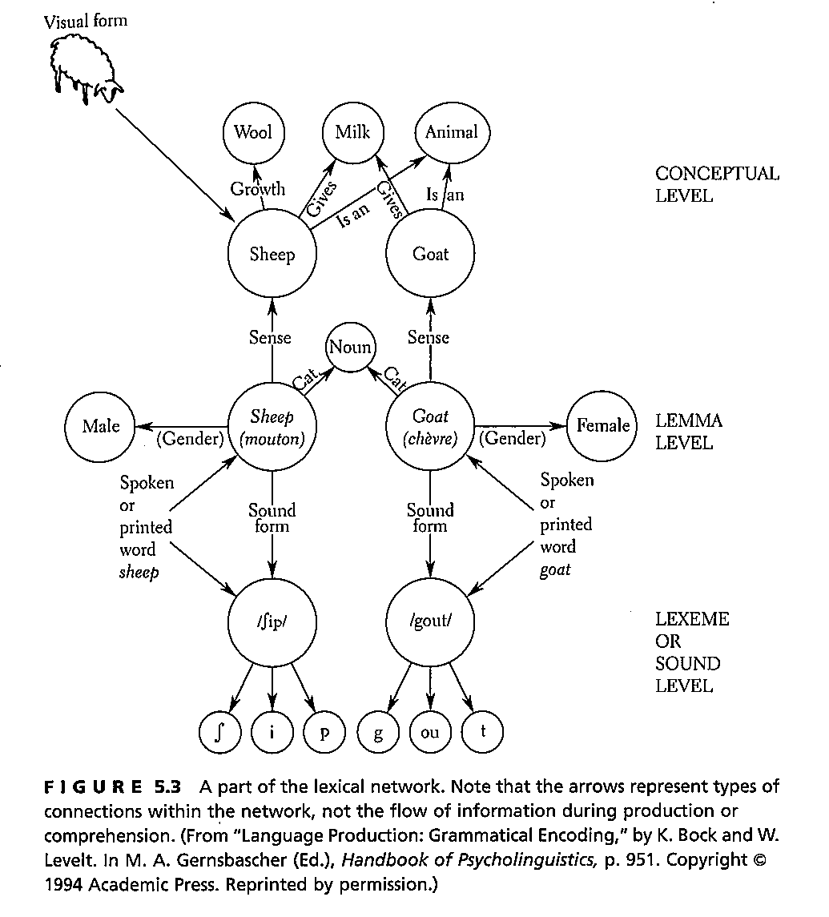
Notes:
Master of None episode 1 7:27 to go --- tip-of-the-tongue state example

Slide 46
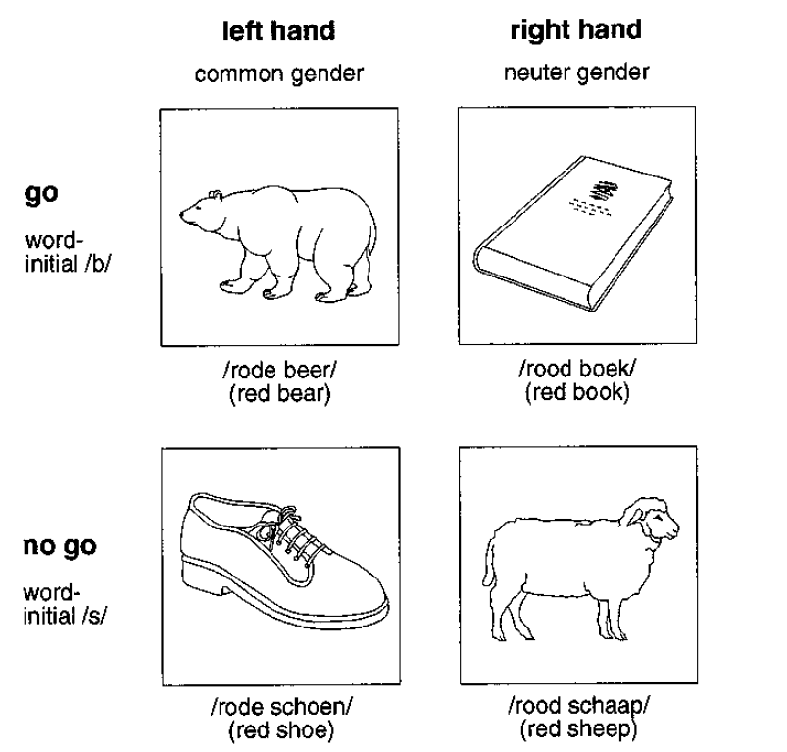

Slide 47
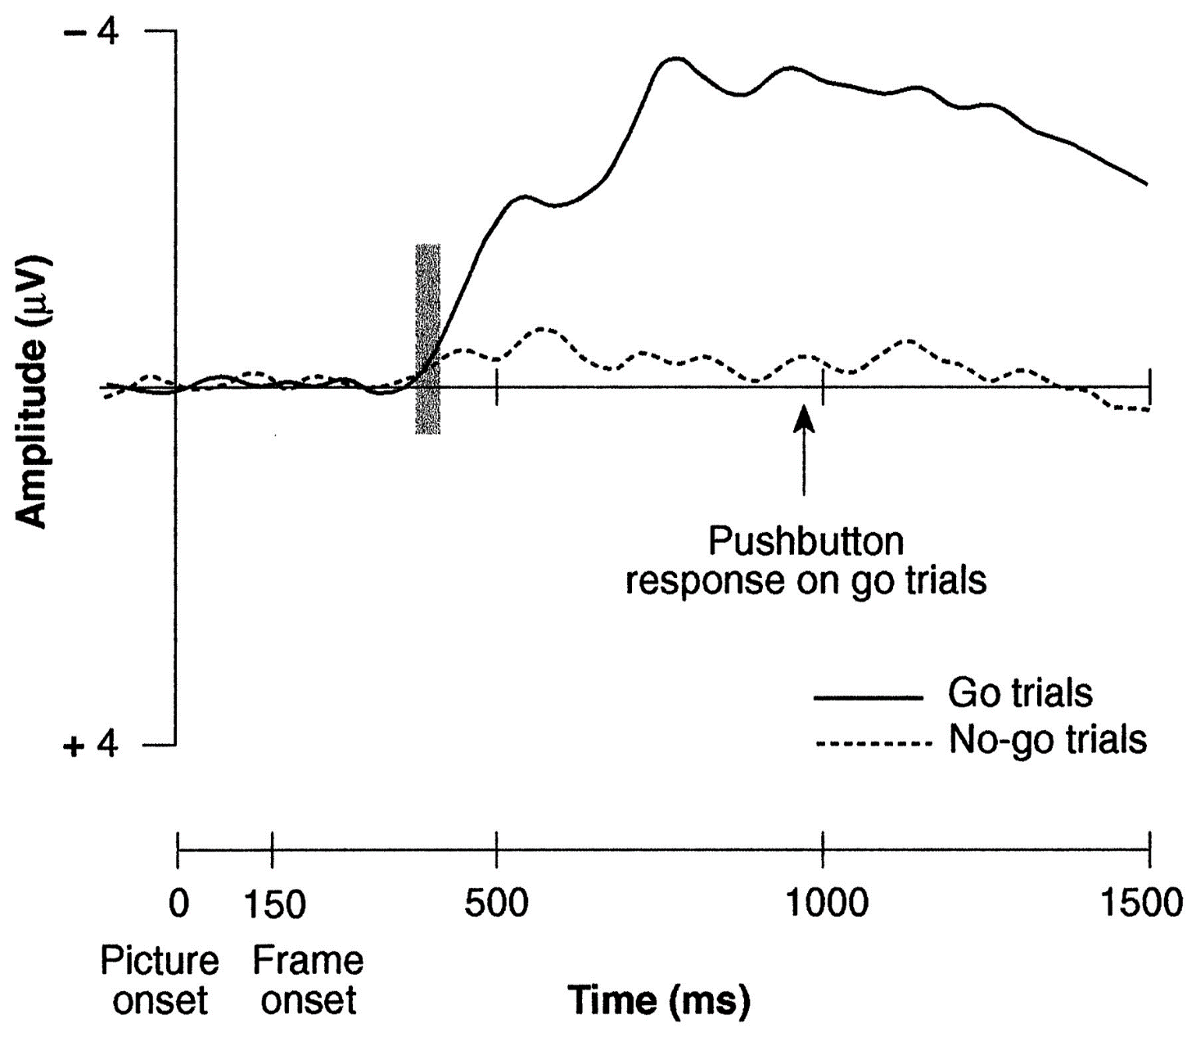
Task 1: do gender judgment if the word starts with /b/, otherwise do nothing

Slide 48
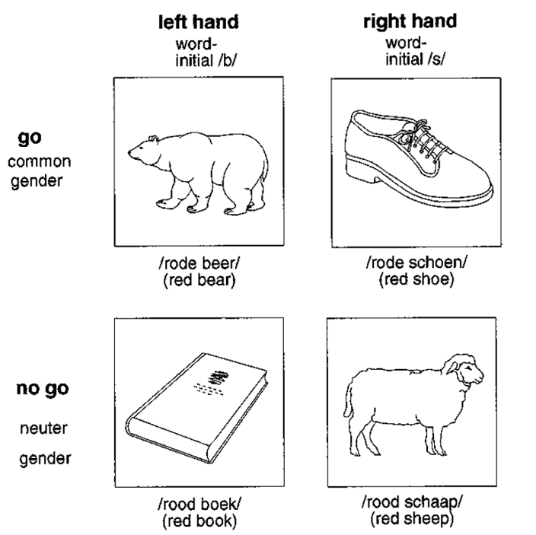

Slide 49
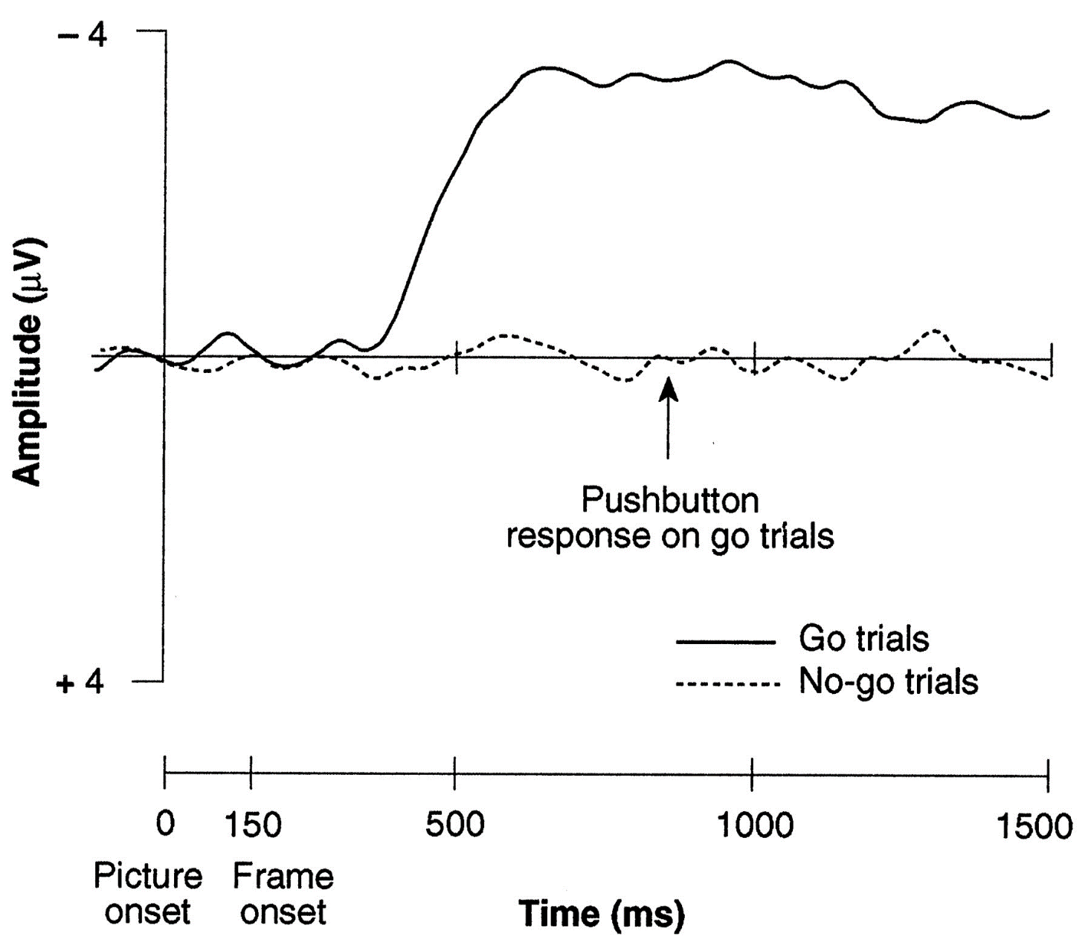
Task 2: do sound judgment if the word is common gender, otherwise do nothing

Slide 50
Van Turrenout et al. (1998)
Morphosyntactic information is activated before phonological information

Slide 51
Van Turrenout et al. (1998)
Not trying to learn about the LRP itself
Just using LRP as a tool to learn about other processes

